Slide 1
Library Management System
Presented by Gabriel Agbo

Slide 2
What will Be Covered?
Objectives
System Requirements
Security Requirements
System Sequence Diagram
User interface
Project Cost

Slide 3
Objectives
The mission of this program is to provide speedy and wide access to update information and save the time of its users or members.
Provide easy ways for librarians to create and store their library collections. It enables students and staff to communicate and collaborate through multiple channels.

Slide 4
System Requirements
Only authentic user with a valid member card must have the access to the system
User must be able to Search, Rent, and Return a book
User must enter issue and return date in database
Same user ID cannot rent more than 5 books
User must sign a “DO NOT COPY DISCLAIMER” consent before checking out

Slide 5
Security Requirements
System will use secured database
Normal users can only read information
System will have different types of users and every user has access constraints

Slide 6
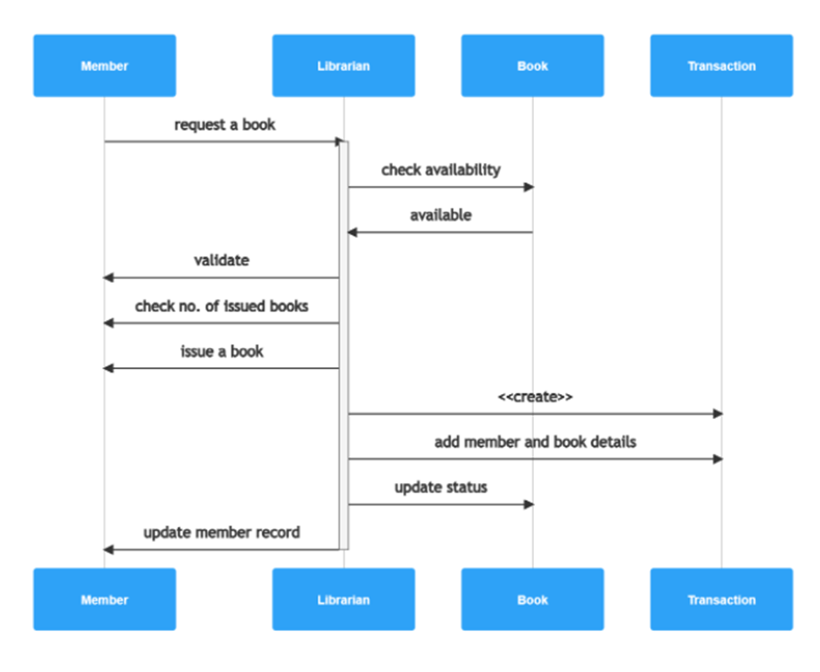
System Sequence Diagram
Notes:
1.Our first transaction will be launched when a member requests a book from the system thru librarian.
2. Next, the librarian will check the book availability in the system and then the member’s status.
3.If the book is available, the librarian now needs to validate member’s request. This is a two-step process of validating membership and also checking the number of books already issued. If the member is authorized to borrow the book, the librarian can now approve the request.
4.The librarian also needs to record the transaction in the library management system, in order to keep our records up-to-date.
5.And finally, the librarian will update the book’s status in the system, so it won’t be available until returned. The librarian will also need to update the member’s record.

Slide 7
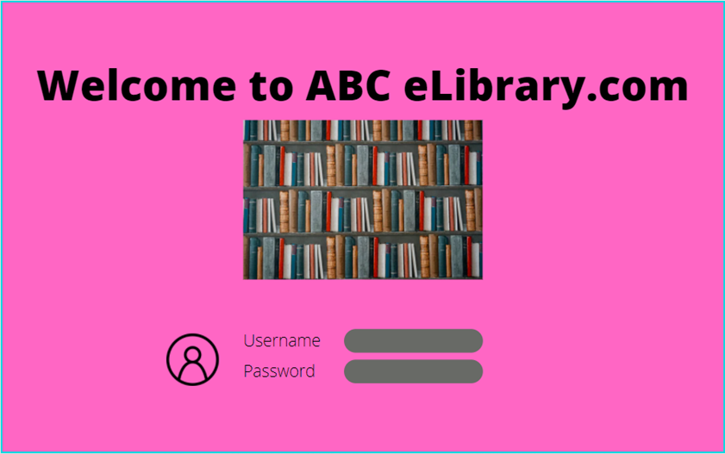
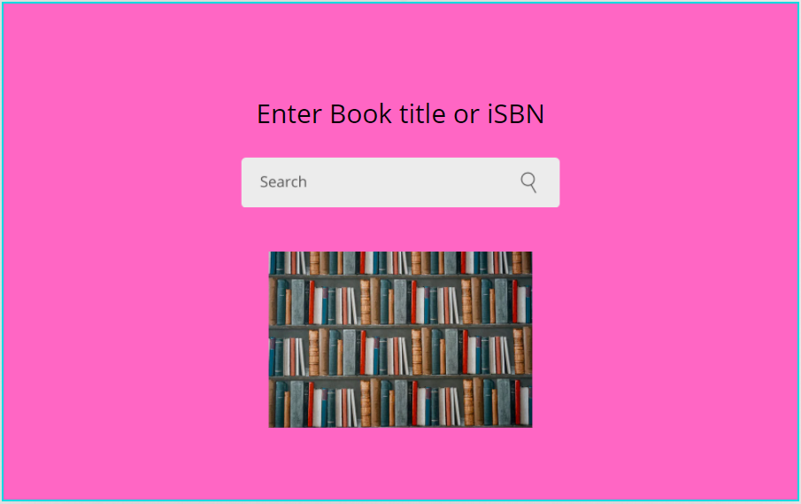
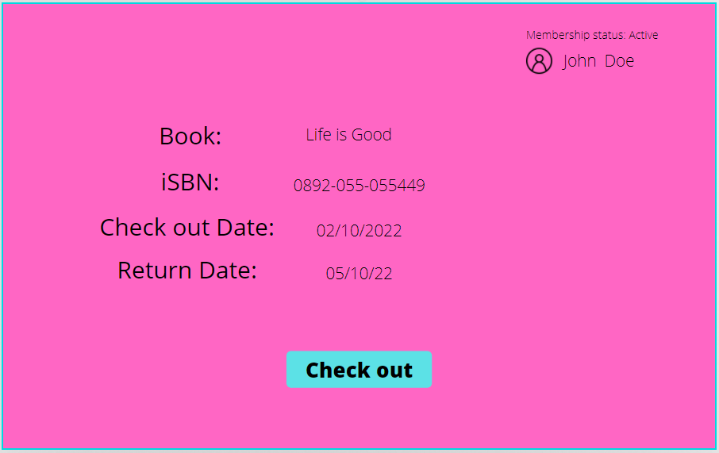
User Interface
Notes:
Based on the prototype we have designed. We can confirm that it will only take about 3 to 4 clicks for a member to borrow a book after login in the system. This is very important for the development of this system. Because it shows how user friendly is the system.

Slide 8
Project Cost
Based on the project size and all the features, the cost range is estimated between $30,000 to $40,000.
Programmers $10,000 - $15,000
Equipment $10,000
Technicians $5,000 - $10,000
Training cost $5,000 - $7,000

